Slide 1


BOOK VERSE RETAIL ANALYTICS
Presented By:
GREESHMA KOLLI

Slide 2
About Me
I’m Greeshma Kolli, an aspiring Data Analyst with an interest in Python. SQL, data analysis, and machine learning.
I built a Book Verse Retail Analytics project using MySQL to analyze book, customers and order data and generate meaningful insights.
Work Experience: Fresher
LinkedIn: https://www.linkedin.com/in/greeshma-kolli-05a3b2260

Slide 3
Agenda
Project Overview
Project Objective
ER Diagram
Database Structure
SQL Analysis & Business Questions
Key Insights & Findings
Challenges/Experience Faced in the Project
Conclusion

Slide 4
Project Overview
Book Verse Retail Business Intelligence & Sales Analytics is a data analysis project focused on understanding the performance of an online and offline bookstore.
The project uses Books, Customers, and Orders data.
The data is stored and analyzed using a MySQL relational database.
SQL queries are used to analyze sales, customers, products, genres, and inventory. The analysis identifies top-selling books, high-revenue genres, valuable customers, and inventory issues.
The findings are used to provide business insights and recommendations.

Slide 5
Project Objectives
To understand Book Verse Retail's sales and business performance.
To build a relational database using MySQL for books, customers, and orders.
To analyze sales performance and customer purchasing behaviour using SQL.
To identify top-selling books, profitable genres, and valuable customers.
To analyze product performance and current inventory levels.
To identify products that require promotion or inventory replenishment.
To generate meaningful business insights and recommendations for management

Slide 6
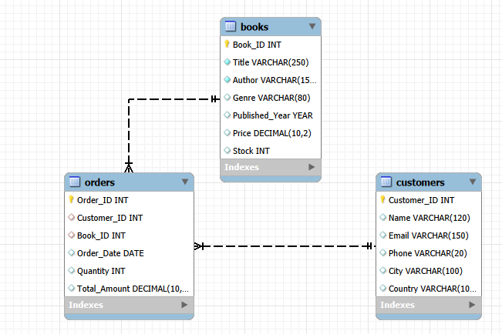
ER Diagram

Slide 7
Database Structure
This project contains 3 interrelated tables:
Books
Customers
Orders
These tables are connected using Primary Keys and Foreign Keys to maintain relational database integrity and ensure consistency across book, customer, and sales data.
The relationships between the tables help in analyzing sales performance, customer purchasing behaviour, product and genre performance, and inventory position.

Slide 8


SQL Analysis & Business Questions
Key Analysis Questions:
1. What is the total number of books?
OUTPUT:

Slide 9

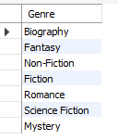
2. What are the different genres?
OUTPUT:

Slide 10


3.What is the total quantity of books sold?
OUTPUT:

Slide 11


4. What is the total revenue generated?
OUTPUT:

Slide 12


5. What is the average order value?
OUTPUT:

Slide 13

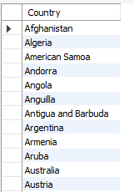
6. What are the different countries?
OUTPUT:

Slide 14
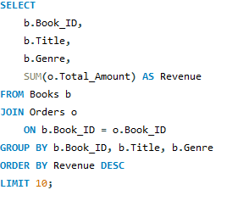
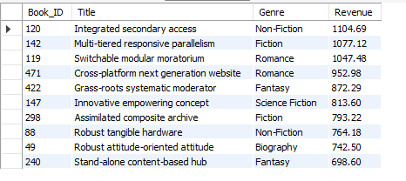
Object Based Analysis Questions:
1. Which books generate the highest revenue?
OUTPUT:

Slide 15
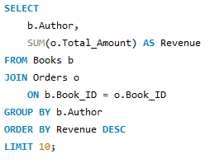
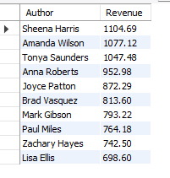
2. Which authors generate the highest revenue?
OUTPUT:

Slide 16
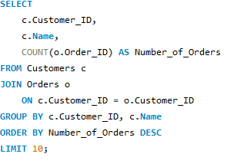
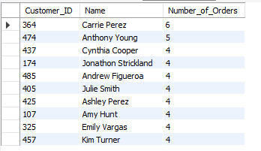
3. Which customers place the most orders?
OUTPUT:

Slide 17
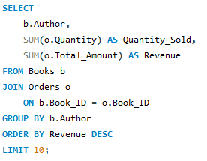
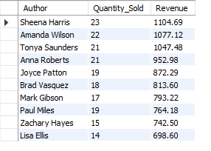
4. Which authors perform best?
OUTPUT:

Slide 18
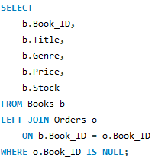
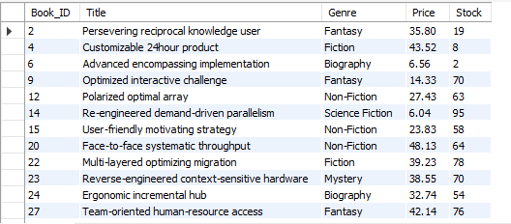
5. Which books have never been ordered?
OUTPUT:

Slide 19
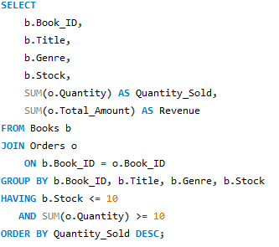
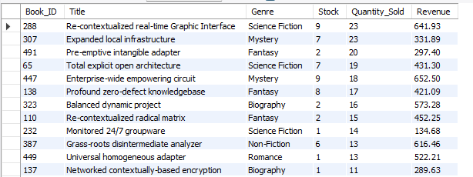
6. Which books have low stock but high sales?
OUTPUT:

Slide 20
Key Insights & Findings
Found the best-selling books and books generating the highest revenue.
Identified the top-performing genres and authors based on sales and revenue.
Found the highest-spending and repeat customers.
Compared customer purchasing behaviour across different countries.
Identified books with low stock and high sales that may need replenishment.
Found books with high stock but low sales that may need promotional attention.
Identified books that have never been ordered.
Used SQL queries to find sales, customer, product, and inventory patterns that can help Book Verse make better business decisions.

Slide 21
Challenges / Experiences
Learned to design a relational database using Books, Customers, and Orders tables.
Practiced creating Primary Key and Foreign Key relationships.
Learned to use JOIN operations to combine data from different tables.
Practiced using GROUP BY, COUNT(), SUM(), and AVG() for analysis.
Learned to perform date-based sales analysis using order dates.
Faced the challenge of identifying top-selling books and high-revenue genres.
Analyzed customer purchasing behaviour and identified repeat and high-value customers.
Worked on identifying low-stock and high-stock/low-sales books.
Used SQL analysis to find business trends, patterns, and inventory opportunities.

Slide 22
Conclusion
The Book Verse project successfully analyzed sales, customers, products, genres, and inventory using MySQL.
SQL queries helped identify top-selling books, high-revenue genres, and valuable customers.
The analysis also identified books that require promotion or stock replenishment.
Customer purchasing patterns and sales trends provided useful business insights.
Overall, the project shows how SQL and data analysis can support better sales, marketing, and inventory decisions for Book Verse.

Slide 23
THANK YOU

